Slide 1

Streamlining The Design And Implementation Process of Dynamic Three-Dimensional Game Development
Lochlann O Neill
R00175741
Notes:
Hello, as you know my name is Lochlann O Neill.
My project is about Streamlining the design and implementation process of dynamic three-dimensional game development.

Slide 2


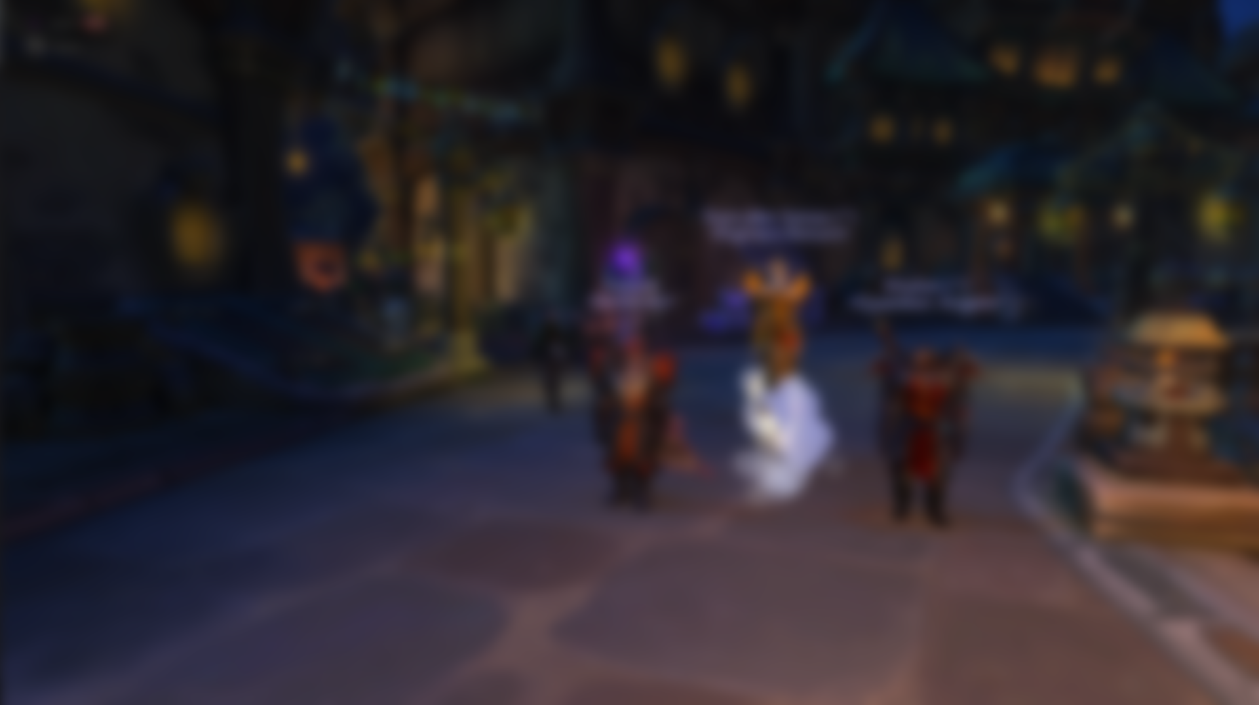





Introduction
Notes:
(Introduce yourself and explain your project motivation)
So, before I get started, I’m just going to give a quick introduction about myself.
This’ll include my history with gaming, and my core motivations for the project itself.

Slide 3


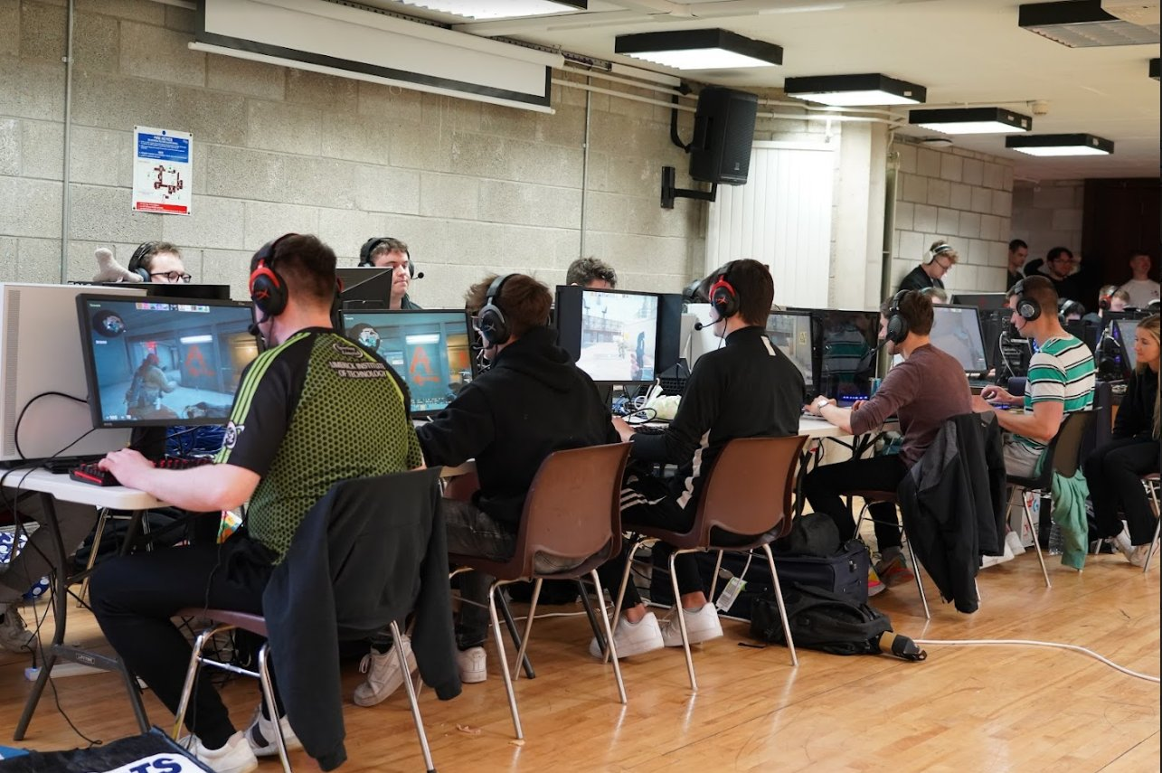
Introduction
Gaming has always been a strong passion
Systems
PlayStation 2 - 2005
Xbox 360 – 2007
Shared my first computer - 2013
Built my own computer – 2019
Tournaments
Irish CS:GO Tournaments – 2019, 2021, 2022
European Valorant Tournaments - 2020
Notes:
For as long as I can remember, gaming has always been a strong passion of mine. As you can see in the top-right picture of my siblings an I holding an Original Xbox remote. I’m not sure what we were playing, but it looked like we were having fun anyway.
It all started when my dad introduced me to the game “Freedom Fighters” on the PlayStation 2, roughly back in 2005. I remember both me and my brother were instantly fascinated by this. And we didn’t stop there, we would continue to many other games too.
As you see on the left here, you can see my timeline on how I progressed through each of the gaming systems I’ve had throughout my life. After the PS2, my brother and I would get the Xbox 360 soon after its initial release date. A few years later we would then share a computer between us. But after some time, we would each eventually go on to build own computers in 2019 with the money we got from working during Summer. This is even the computer I still use to this day, making many upgrades to it as time passes so it doesn’t become obsolete.
I’ve even attended many tournaments in games like CS:GO and Valorant. Most of them were online because of the covid lockdowns. But the most recent one I attended was a LAN located on the UL campus. I even played on the MTU e-sports team for a while.

Slide 4
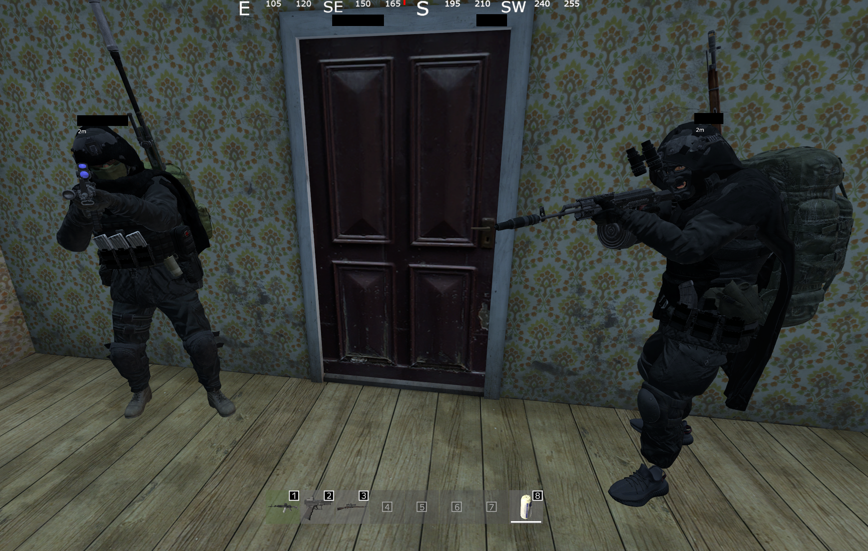
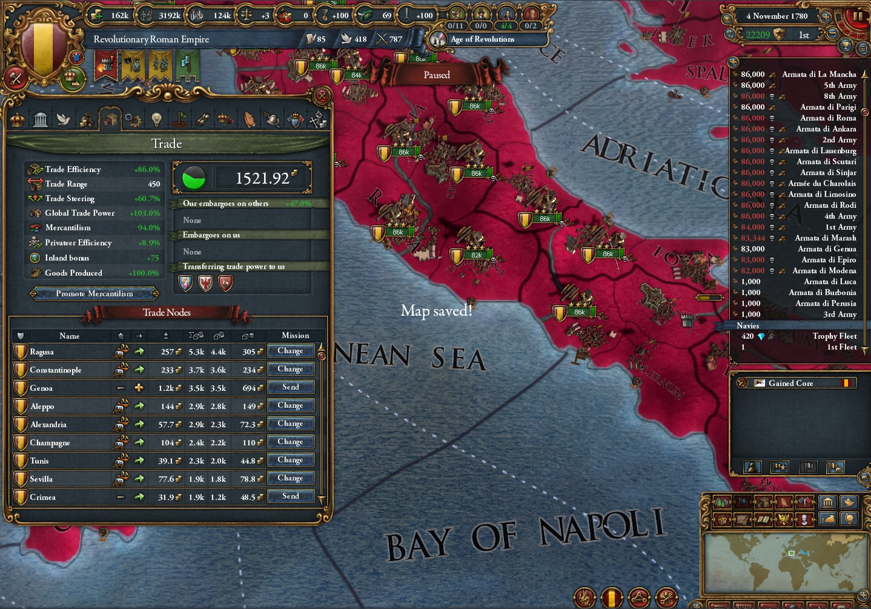
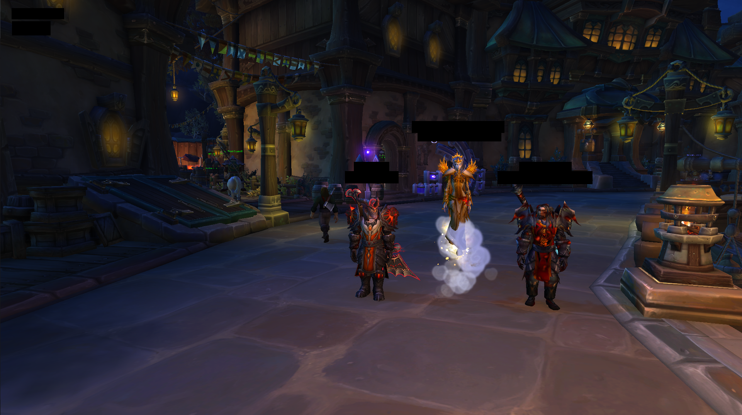
Introduction
Favourites
CS:GO – competitive fps
DayZ – survival pvp
Europa Universalis 4 – real time strategy
RuneScape – mmorpg
World of Warcraft - mmorpg
Notes:
You can see some of my favourite games here.
My top 5 of all time would have to be CS:GO, DayZ, EU4, RuneScape and World of Warcraft. I’d say I’ve spent a ridiculous amount of time on these games combined.
With all this experience in gaming over the years, I feel like I’ve really started to understand their general flow, and that kind of leaded me to think that it would be the best area for me to do a final year project in.

Slide 5
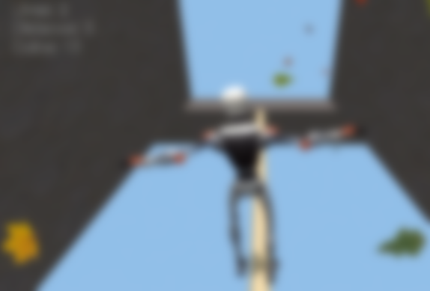
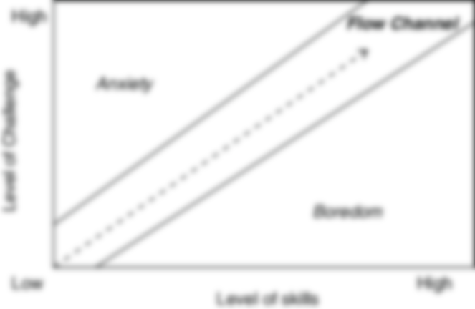

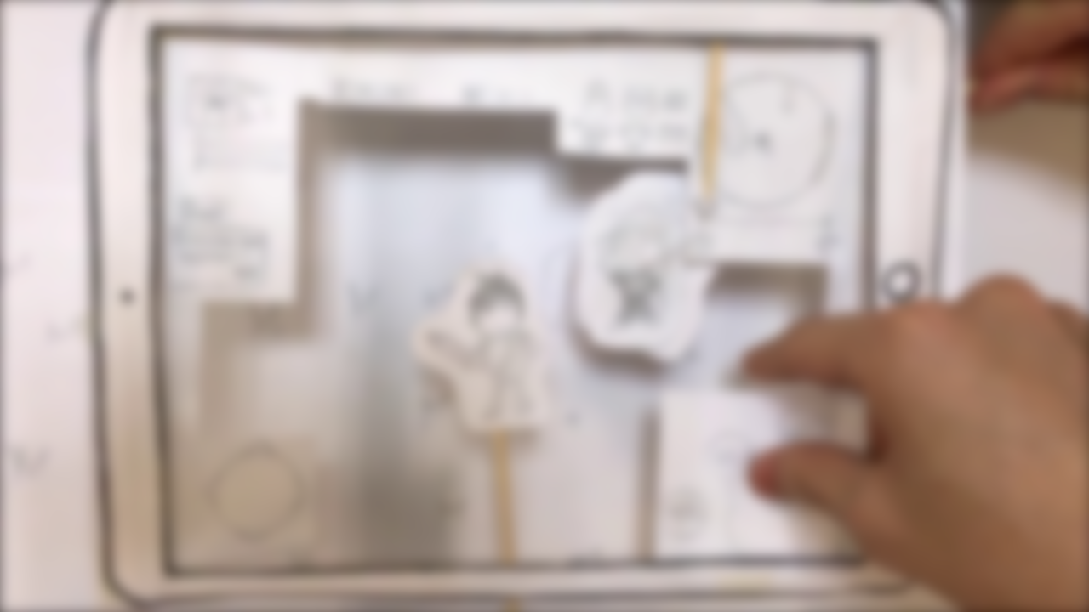
Background Research
Notes:
(Clearly convey the extent of your project research and your research conclusions)
And now, onto my background research on this whole topic.
This will include the design process and characteristics of a game.

Slide 6
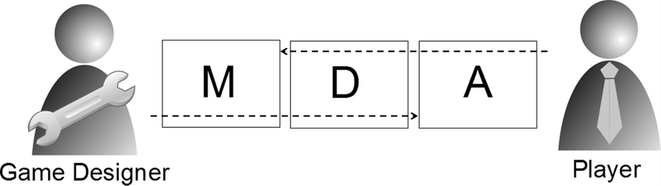
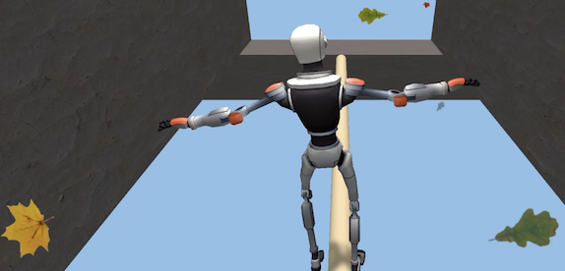
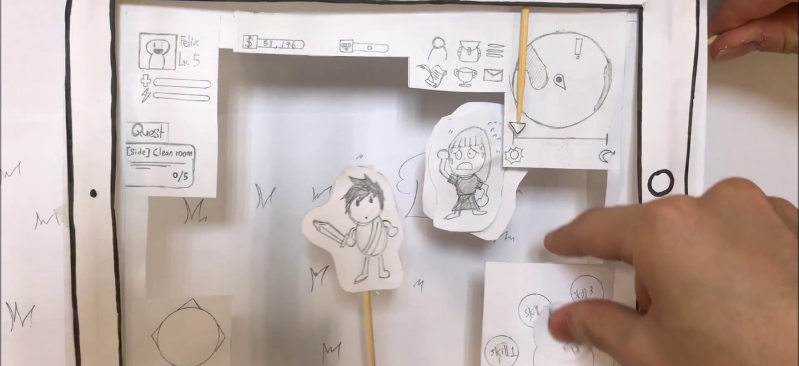
Background Research
The Design Process
Idea Generation – identify, brainstorm, refine, choose, develop
Play Context – focused / unfocused
MDA Framework – mechanics, dynamics, aesthetics
Notes:
The development of any game starts with its design.
A great quote I saw somewhere before was that “Good design is making something intelligible and memorable, whereas great design is making something memorable and meaningful”. I think this perfectly encapsulates the mindset a developer should have when designing software.
When designing a game, a developer should always keep in mind the specific play context in HOW they believe a player is expected to experience their game. If the target audience includes a player sitting at home in front of their computer, the game may involve a lot of focus and full cognitive attention at all times. This may be the opposite for games that are played while in public, which are only played to pass the time. Regularity should also be determined in game context, because it might be difficult for players to know what’s going on in their game if they haven’t played it in a while. In some cases, it might be more suitable to be able to just pick up the game and start playing with little-to-no context.
The MDA framework disassembles games into three categories: their mechanics, dynamics and aesthetics. As you can see in the picture in the top right of the slide, each category has close interrelational ties with its bidirectionally adjacent layers. So for example; mechanics directly impact dynamic and aesthetics are impacted by dynamics. Mechanics are particular actions taken by the player, dynamics outline the run time behaviour, and aesthetics describe the evoked emotions. As seen in the graph above, designers tend to see from mechanics to dynamics to aesthetics, whereas players tend to see from aesthtics to dynamics to mechanics

Slide 7
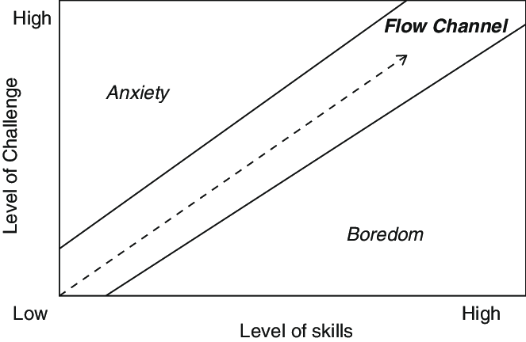
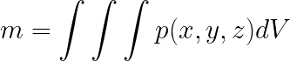
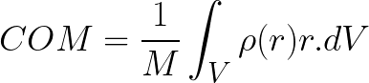
Background Research
Characteristics
Conceptual – genre, rules, perspective, space, reality, flow, balance
Practical – game loop, dimensions, physics, controls, graphics, music
Notes:
I’ve split the characteristics of a game into two categories; conceptual and practical.
Conceptual game characteristics focus on the general abstract ideas and concepts of a game, rather than their actual implementation. This could include things like its genre, rules, perspective, space, reality flow and balance. They determine HOW a player is intended to FEEL when they’re playing the game, mainly portraying the game’s overall aesthetic.
In my research paper, I described the practical characteristics as being the tangible elements within the game world. What I mean by this, is that they although they’re not technically real, they can still be PERCEIVED in a literal sense by the senses. They would include things like the game loop, dimensions, physics, controls, graphics, music.

Slide 8
Problem Definition
Notes:
(Clearly state the goals and objectives of your project)
Now for the specific goals and objectives of my project.

Slide 9
Problem Definition
Comprehensive practical guideline
Provide a fully-functioning example game
Requirements
Functional
Non-functional
Notes:
This project hopes to outline a comprehensive practical guideline for creating dynamic games in Unity.
Where I hope to deliver a full functioning example game at the end.
There’s going to be a lot of requirements that’ll need to be completed, both functional and non-functional.

Slide 10
Problem Definition
Functional Requirements
Character Objects
Movement
Camera
Items + item containers
Combat
Inventory
Equipment
Compass
Animations
Sneaking
Quests
Unique 3D art
Game State Persistence
Enemy Advanced Intelligence Using Finite-State Machines (FSM)
Notes:
You can see most of my functional requirements here. They’re the specific functions and capabilities of the game.
I can’t talk about each one thought because I’m kind of of short on time.

Slide 11
Problem Definition
Non-Functional Requirements
Performance
Scalability
Maintainability
Aesthetics
User Experience
Notes:
The Non-functional requirements are what determine the overall quality of the game experience.
But again, I can’t talk about each one here because of a shortage on time.

Slide 12
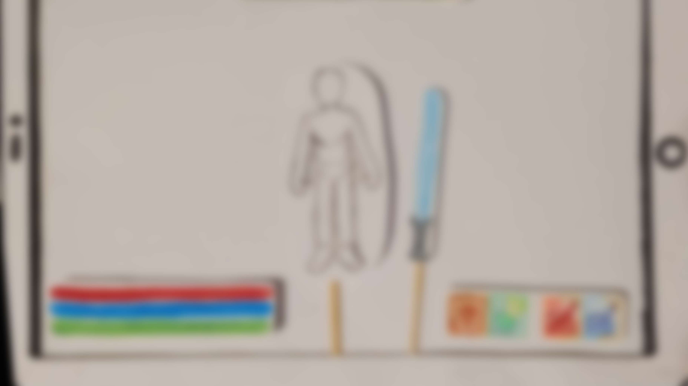
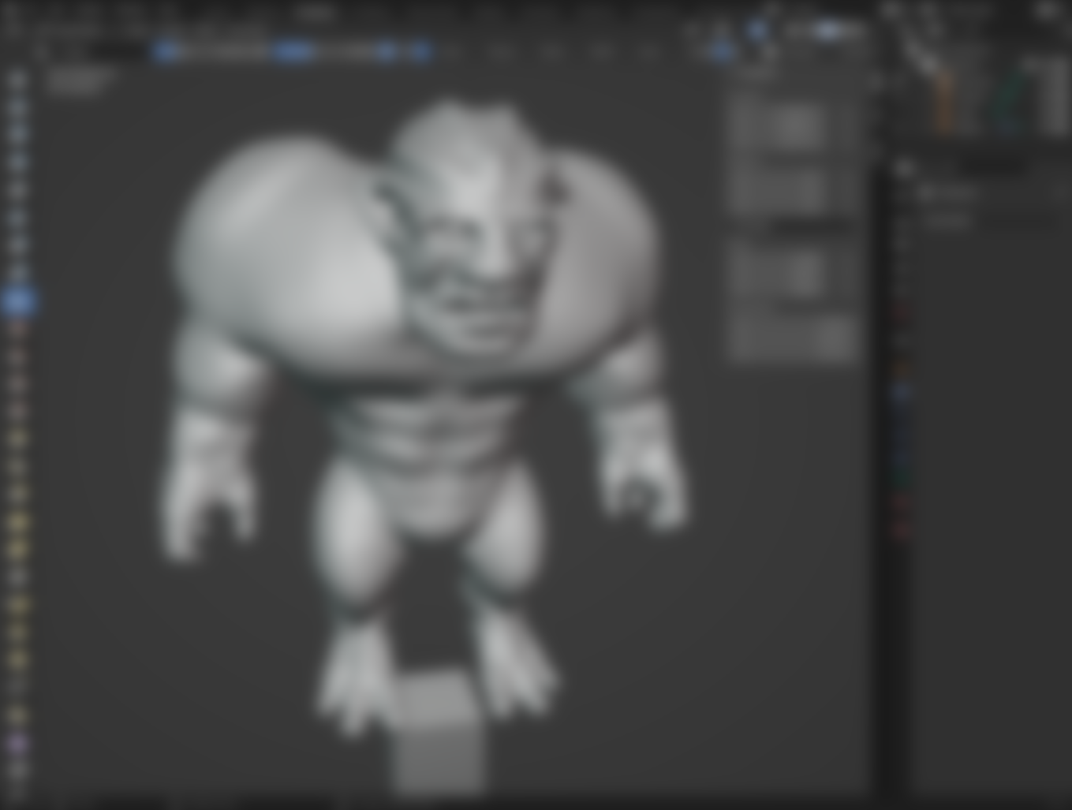
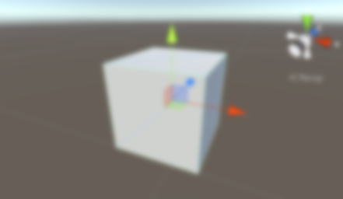
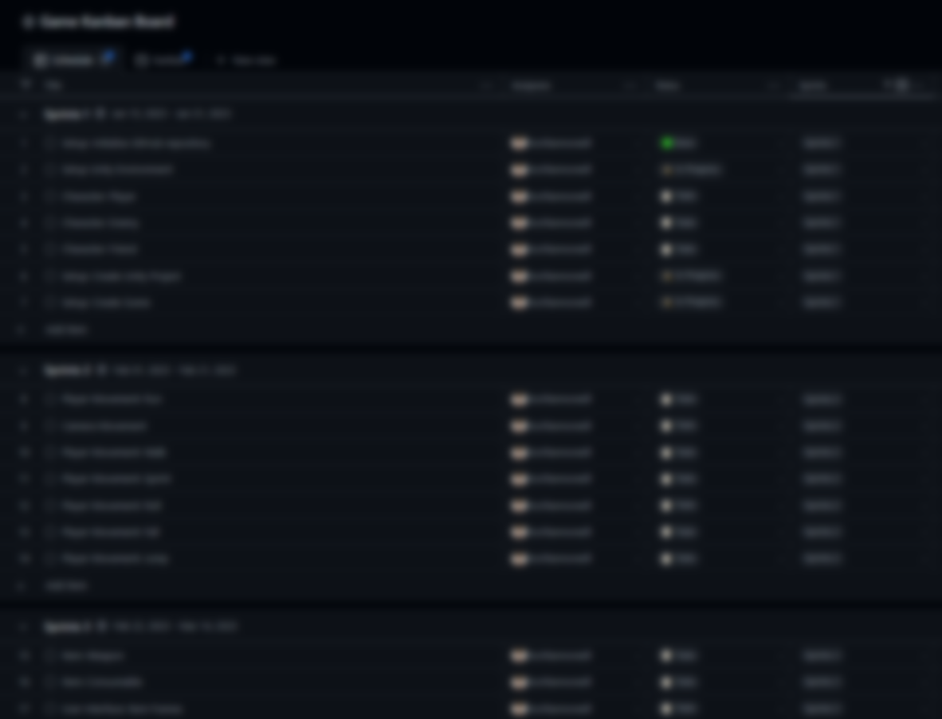
Implementation Approach
Notes:
(Clearly show how you plan to implement your project and discuss how you will address the implementation risks)
Now I’m going to talk about how I’m going to plan and actually implement this project.

Slide 13
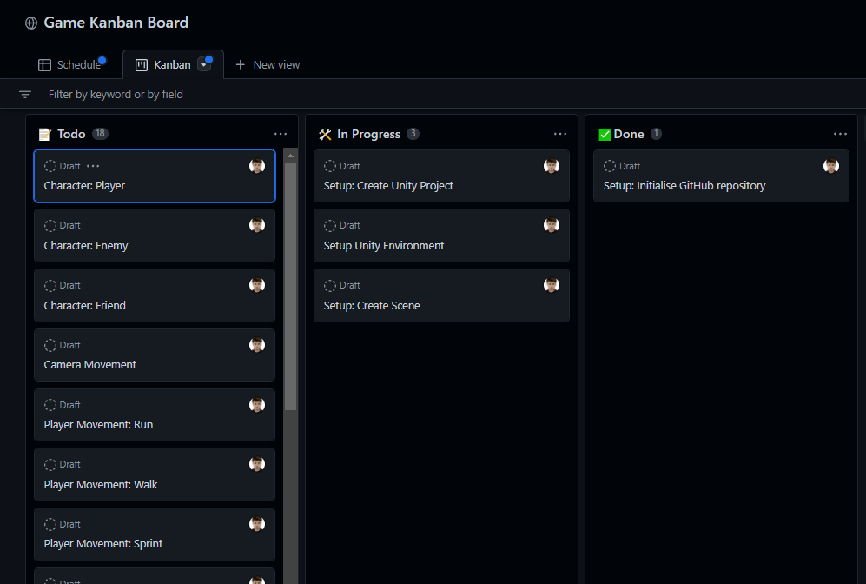
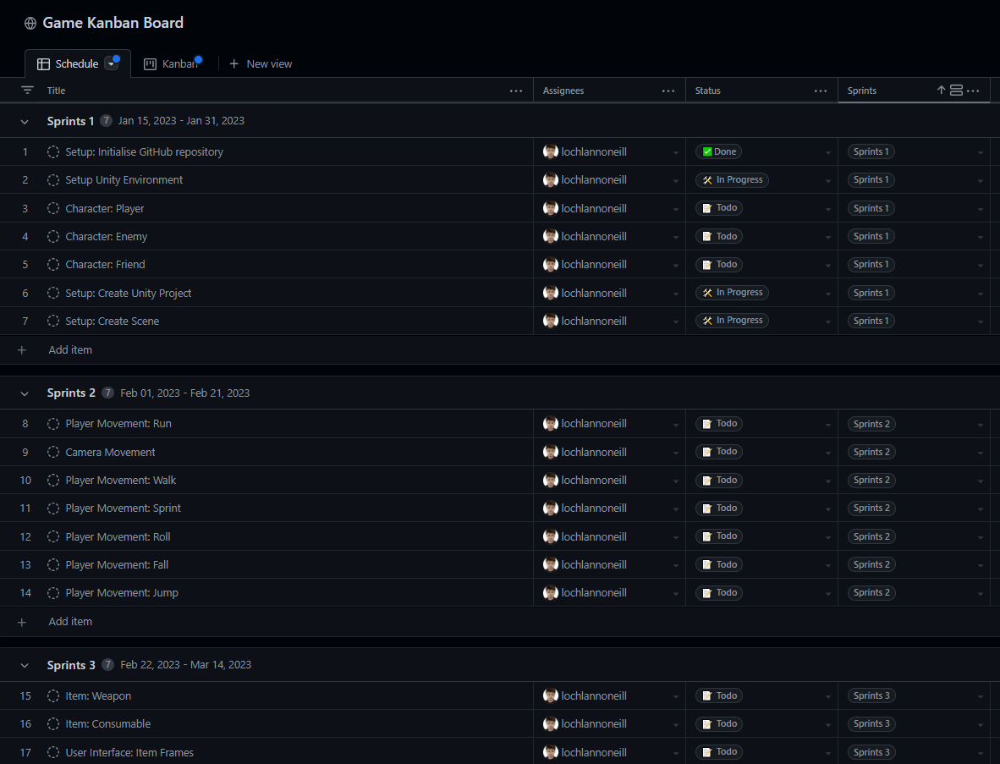
Implementation Approach
Agile Methodology
Schedule
Sprints
Kanban
Semantic Versioning 2.0.0
Major, Minor, Patch – 0.5.14
GitHub – version control
Notes:
I’ll be making extensive use of the Agile Methodology throughout the implementation phase.
As you can see in the images to the right, I’m going to keep a guideline of each specific feature I plan on developing. All of these specific features are going to to be lumped together in Sprints which are going to be completed in regular intervals, as is standard with Agile development. A Kanban board is going to be used to separate each deliverable feature into categories; todo, in progress, and done.
Semantic versioning shows where the state of the game is currently at. By using GitHub commits for version control, I can define each push as being a Major, Minor, or Patch. For the scope of this project, each sprint will be defined as Major, each deliverable will be considered minor, and everything in between will be considered a patch. So the final result should be something along the lines of 3.10.32

Slide 14
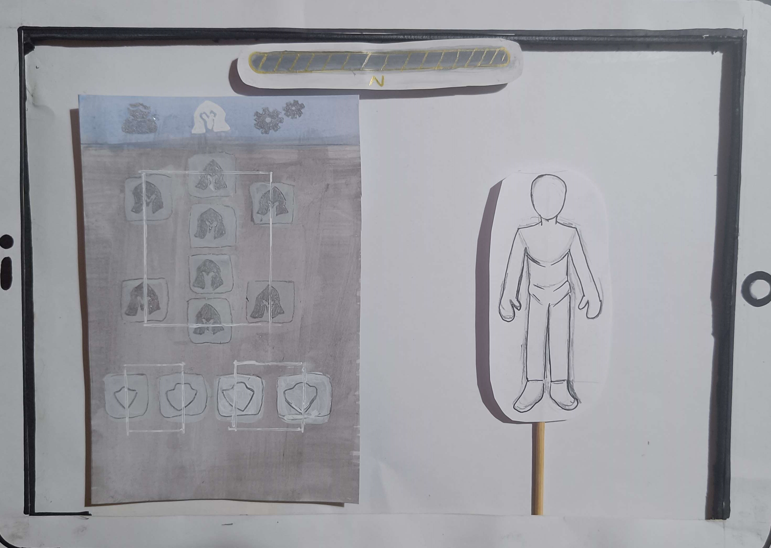
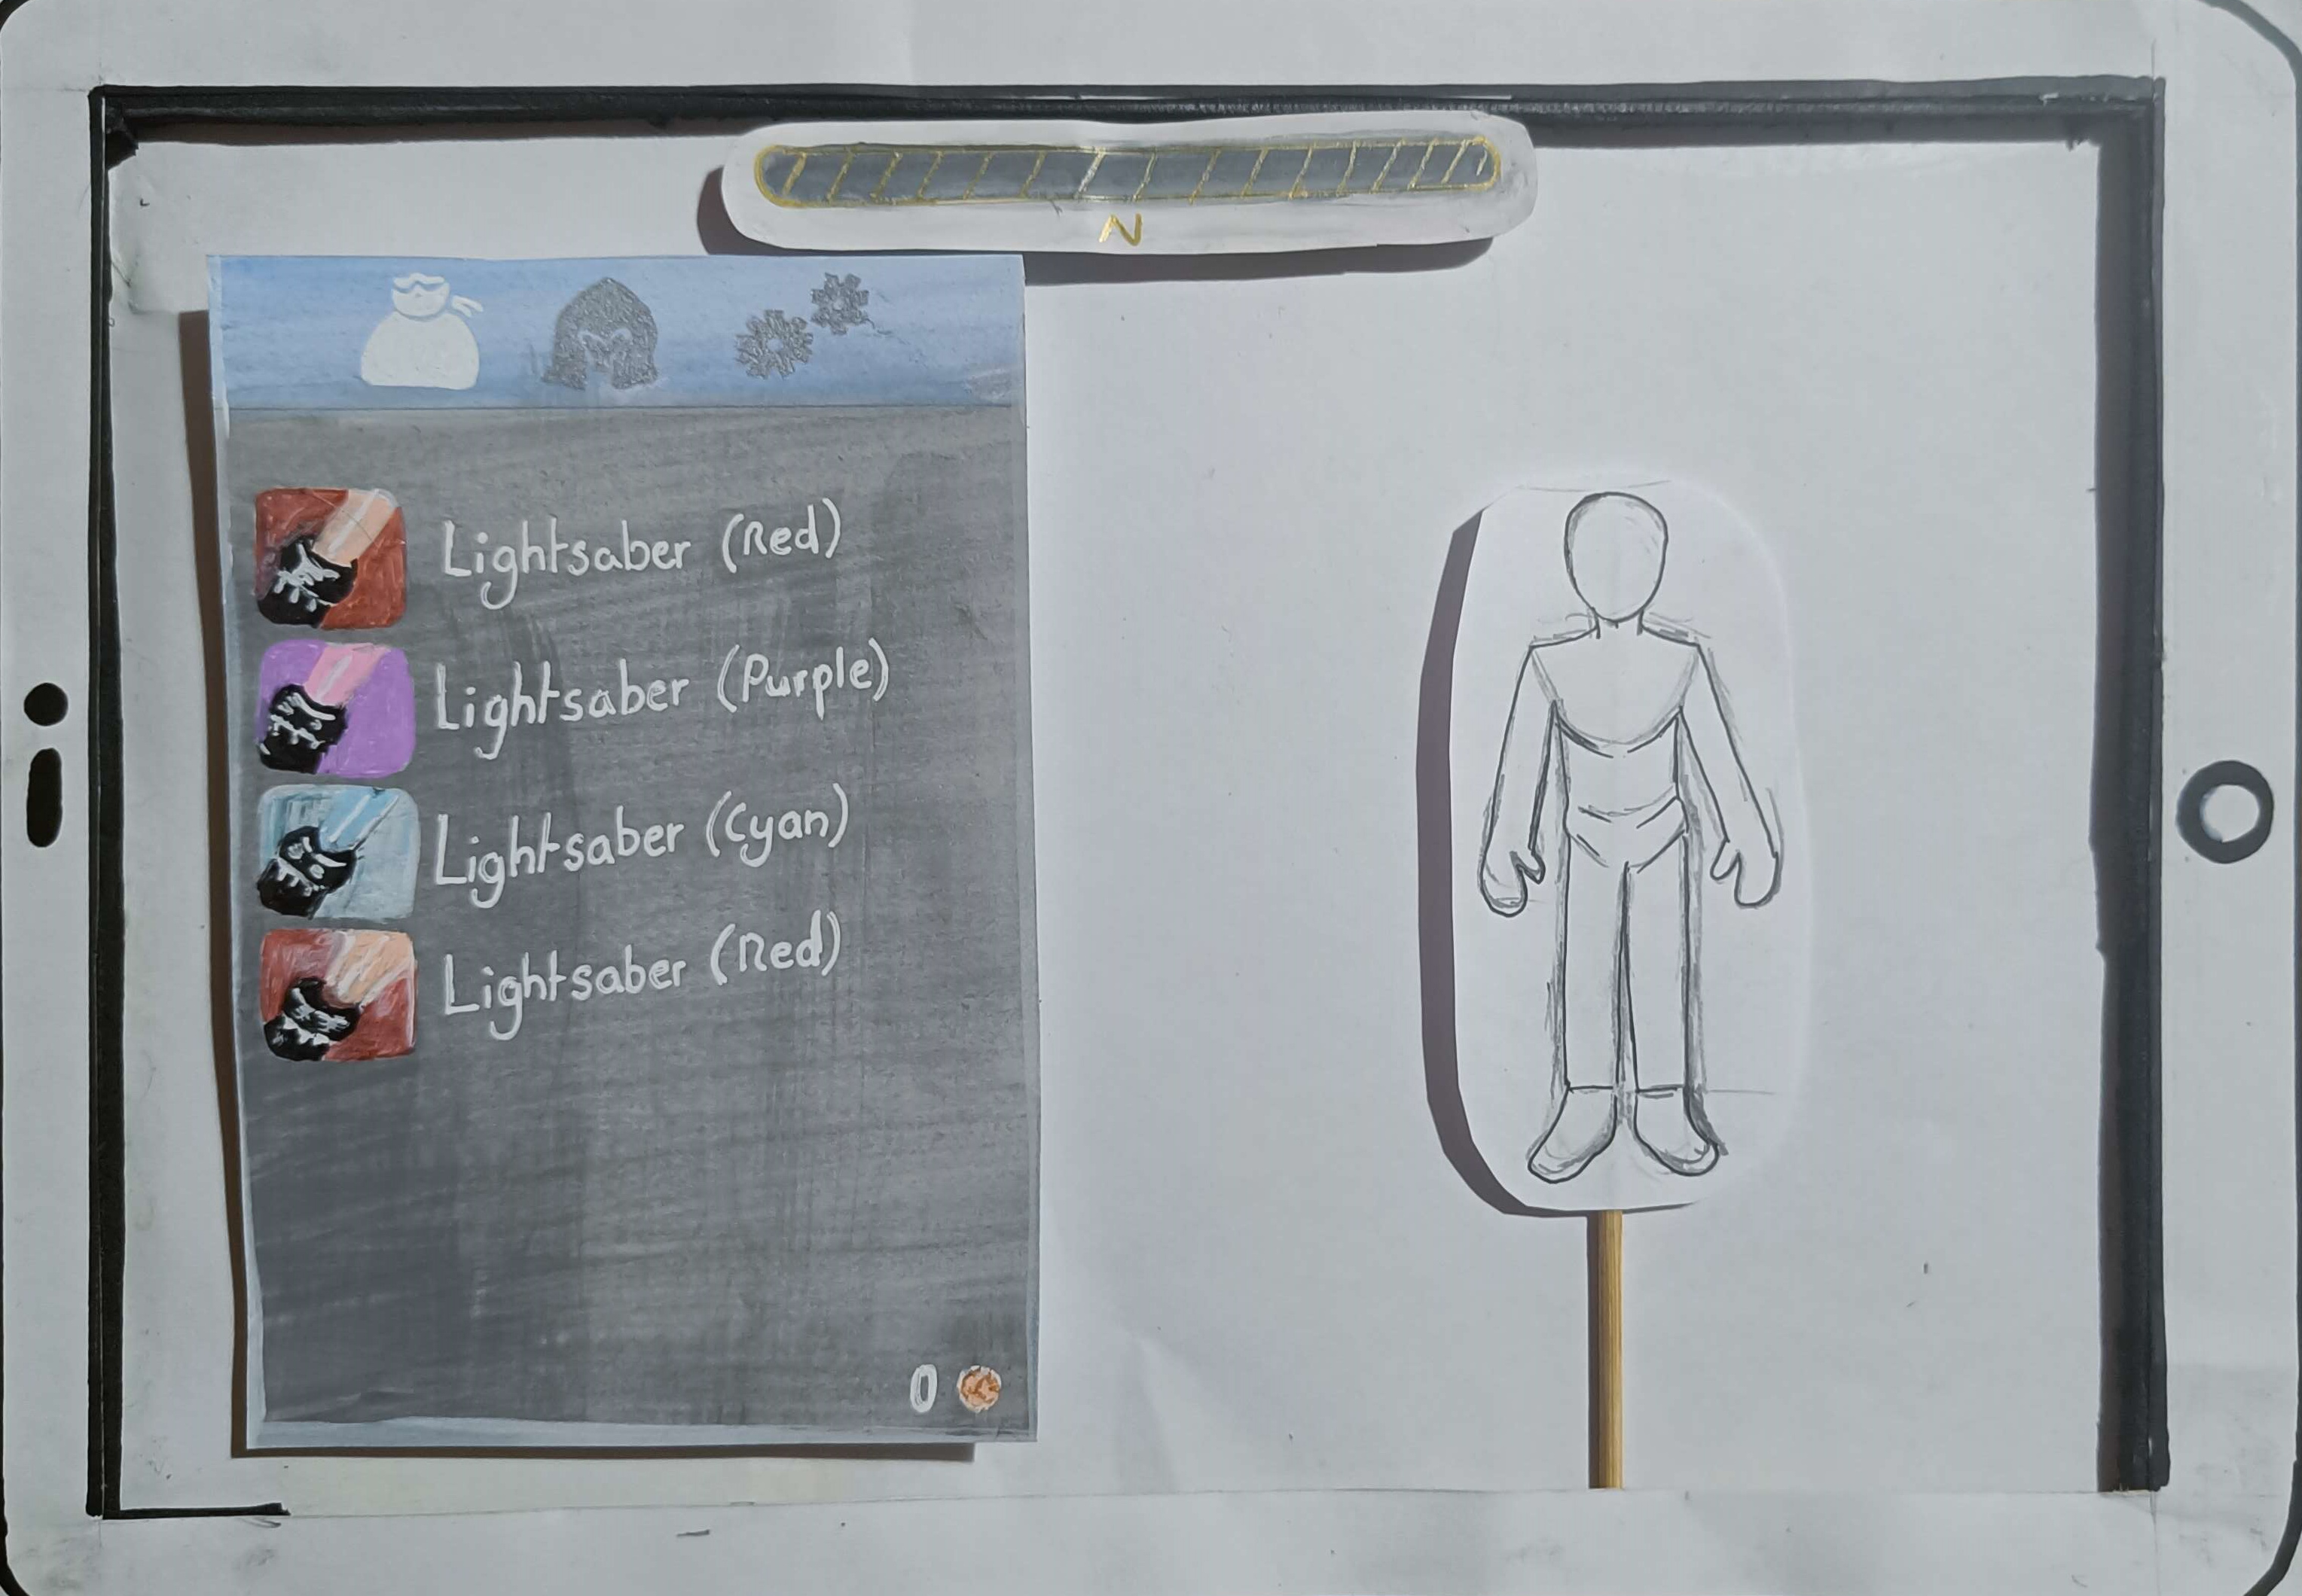
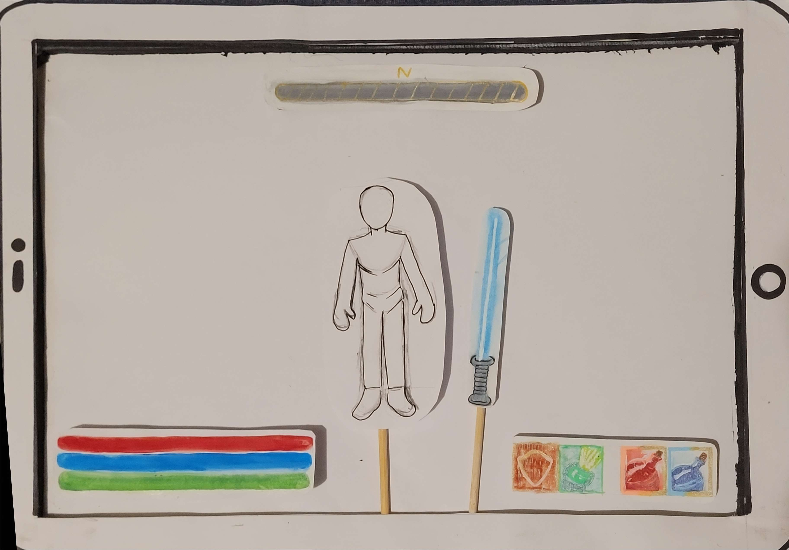
Implementation Approach
Paper-Prototypes
User Interface Components
Interactivity Concepts
Notes:
During the design phase, its always a good idea to first create some paper prototypes.
They’re a cheap and fast way of easily portraying the basic elements of the intended final result of a project, like individual UI components and general interactivity concepts.
They’ll save a lot of time in the future, because its better to make corrections on a piece of paper than an entire complex codebase.
As you can see to the right, my sister made some paper prototype for my game based on my description and rough drawings. I thought they were pretty cool because you can actually move the components around how you see fit.

Slide 15
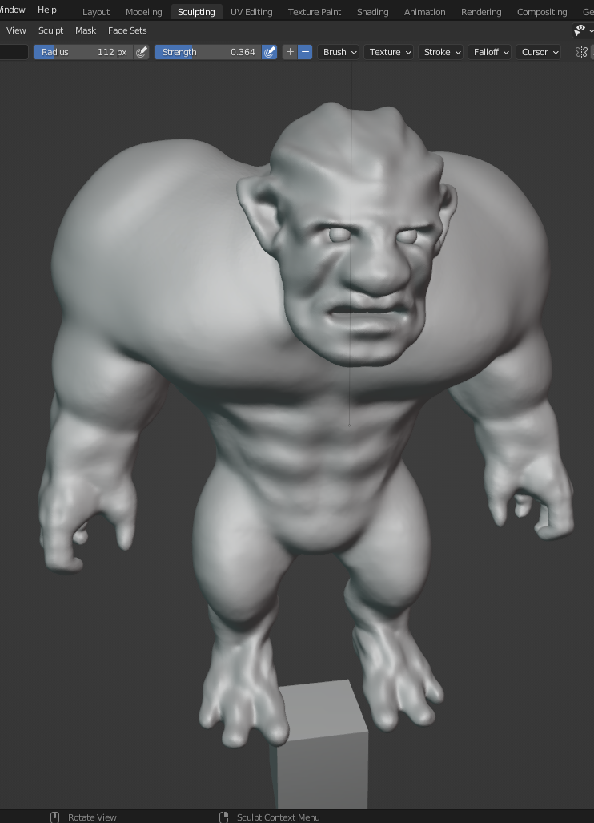
Implementation Approach
Blender
3D Models – unique / referenced
Skeletal Mesh – polygons, bones
Tutorials
Notes:
A couple of years ago, me and my brother tried to learn how to use Blender for fun. As you can see, the model on screen was our attempt at creating an enemy character. Although it has been some time, I’m sure I can easily pick up where I left off.
Something I must learn though, is how to properly add a bone structure to the model’s skeletal mesh. This should allow the model to move around in a realistic way, moving their limbs as they do so. I’m sure there are many tutorials online showing how to do this properly.
But I understand that I may not have time to create all of the art in my game, since I will be under extreme time constraints. So I may end up using a lot of referenced art instead. I do want to have at least one original model, just as a proof of concept.

Slide 16
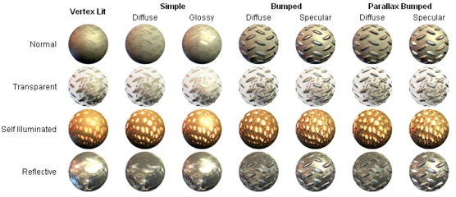
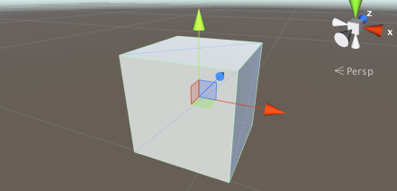
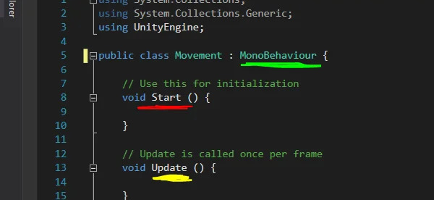
Implementation Approach
Unity
Scenes
Objects – primitive, static, dynamic
Scripts – MonoBehaviour
Materials
Tutorials – Roll a ball, Create with Code
Notes:
Unity is an open-source game engine that I’ll be using throughout all stages of my implementation phase.
Objects are data structures that represent characters or props in a game. The 3D model I mentioned before will become a game object when imported to unity.
Materials are what give an object an appearance, also known as skins. I can determine things like shininess, transparency, and reflectivity.
Scenes are collections of game objects. It is like a stage that presents everything in the current instance to the developer.
Scripts are what dictate the behaviours of objects. This is where I’ll be using functions like ‘start()’ and ‘update()’ to enable objects to perform actions, like controlling movement and handling collisions.
I’ve already finished a couple official Unity turorials like roll-a-ball and create-with-code to familiarize myself with interface navigation and implementation concepts.

Slide 17
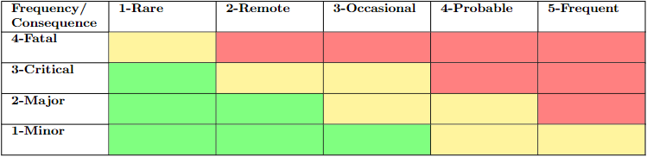
Implementation Approach
Risk Assessment
Time Constraints
Resources
Scope Creep
Quality
Inadequate playtesting
Notes:
Now, there’s obviously a lot of risks associated with projects such as this.
Throughout the project, I may feel an overwhelming sense of impending deadlines. This is why I’m going to have to do my best to stay on top of my workload at all times throughout the next semester.
I may not have access to specific resources needed to complete certain aspects of development. This could range from anything between no acceptable game art to no sufficient learning material.
As development progresses, I may find that the scope of the project keeps increasing. Although I feel like I already planned for all the required deliverables, I may find that they are not enough to present a working game.
When I get to the stage where I can present a working high-fidelity prototype, I may find that the quality of the game is lacking. I’ll have to develop interesting dynamics to keep the game engaging.
To do this, I also have to remember to regularly conduct third party playtesting to make sure the this quality is kept to an acceptable standard.

Slide 18
Conclusions
Notes:
(Clearly state what you have learned from the research phase)
After researching about this topic, its definitely clear that this is going to be a difficult and especially long task, that im going to have to put a lot of time into. On the other hand, in the unlikely occurrence that I finish early, I may even add some extra functionality to the project.
The importance of planning was really outlined to me. If I were to start implementation without research, I would be completely lost. As Abraham Lincoln once said, “If I had 6 hours to chop down a tree, I’d spend at least the first 4 sharpening the axe”.
All in all, this project aims to provide a practical application of the theoretical and practical knowledge I gained throughout my time at MTU and through individual research.

Slide 19
Questions ?
Notes:
And that’s all for my project!
So thank you for listening, and if you’ve any questions just feel free to ask.

